Slide 1

Espousal Clings ❤
A Musician Booking App for a wedding venue

Slide 2
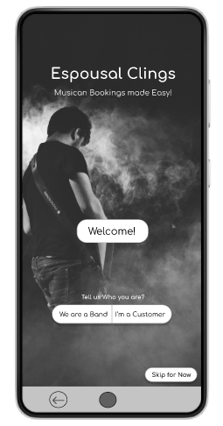

Project overview
The product:
‘Espousal Clings’ app is used to book musicians for a wedding venue. The target users are Wedding Planners, Couples and other event organizers.
Preview of selected polished designs.
Project duration:
1 Month
February 2022

Slide 3
Project overview
The problem:
The couples, their parents and Wedding Planners face problems related to pre-booking the musician band, payments, their performances and choices to choose musician to fit their theme and cultural background.
The goal:
To Create a app “Espousal Clings” that connects musicians of diverse abilities and backgrounds to the customers and enabling the customers to pick their preferred musicians based on their budget, theme and also based on the feedback.

Slide 4
Project overview
My role:
UX designer, UX researcher.
Responsibilities:
User research, wireframing, prototyping, testing.

Slide 5

User research
Personas
Problem statements
User journey maps
Understanding
the user

Slide 6
User research: summary
After Conducting the Secondary Research, The End Users are found to be The Bride and Groom, Their Parents and a Wedding planner.
I assumed that users are facing problems such as finding the best musician band nearby their town and are also doubted on their overall performance quality.
But, after the research, I found that users also needs assistance in comparing the price of the two bands and also wants to know their past performance reviews to make better decisions.

Slide 7
User research: pain points
1
2
3
4
Hard to Compare
Unable to trust
Tiring to Find
Time consuming
It’s hard to compare the two musician bands performances and also their prices.
Cannot easily trust that they will come on time and also provide their best performance.
It’s tiring to locate the best musicians around the town and uncertain about their availability.
It is time consuming to consult the band in-person and to pre book them.

Slide 8
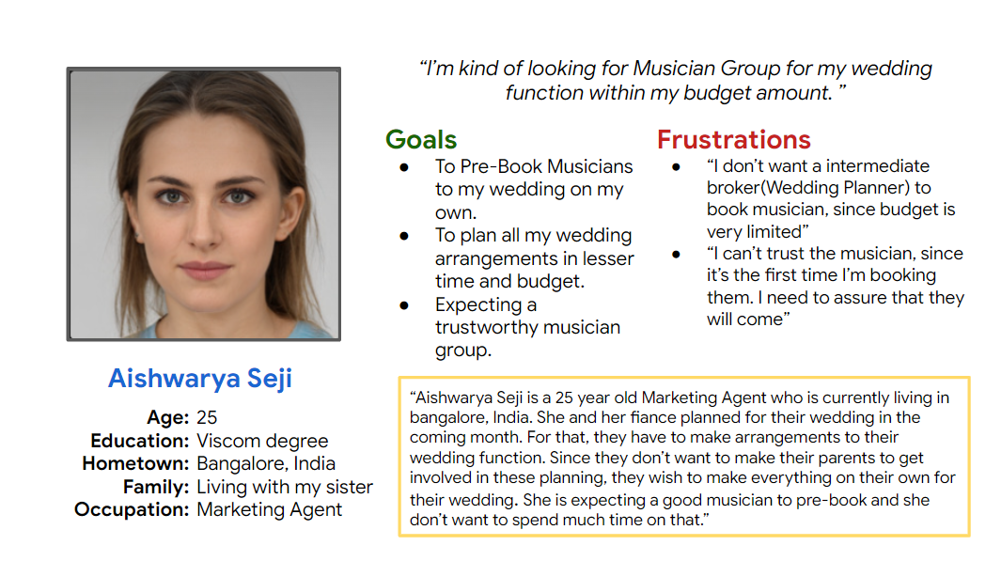
Persona: Aishwarya Seji
Problem statement:
Aishwarya Seji is a marketing agent and currently planning her wedding
who needs to quickly book the best musician band for her ceremony under her budget
because she is busy on planning other tasks and don’t want to spend much time and money on the intermediates.

Slide 9
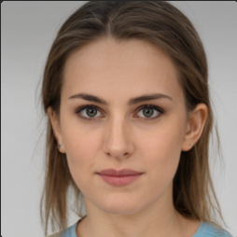
“I’m kind of looking for Musician Group for my wedding function within my budget amount. ”
Goals
To Pre-Book Musicians to my wedding on my own.
To plan all my wedding arrangements in lesser time and budget.
Expecting a trustworthy musician group.
Frustrations
“I don’t want a intermediate broker(Wedding Planner) to book musician, since budget is very limited”
“I can’t trust the musician, since it’s the first time I’m booking them. I need to assure that they will come”
Aishwarya Seji
“Aishwarya Seji is a 25 year old Marketing Agent who is currently living in bangalore, India. She and her fiance planned for their wedding in the coming month. For that, they have to make arrangements to their wedding function. Since they don’t want to make their parents to get involved in these planning, they wish to make everything on their own for their wedding. She is expecting a good musician to pre-book and she don’t want to spend much time on that.”
Age:
Education:
Hometown:
Family:
Occupation:
25
Viscom degree
Bangalore, India
Living with my sister
Marketing Agent

Slide 10
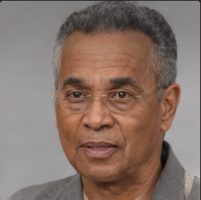
“I want to pick up the best musician for my client based on their budget & preferences with less effort, and more choices to match their taste of music.
Goals
To book musicians with minimal effort.
To ensure that they produce a good experience in the wedding venue.
To make his planning much suitable to their client’s preference.
Frustrations
“It is tiring to continuously search for different musician bands across the town”
“I cannot trust the new musicians on their performance.”
“I am unable to suggest the same set of musicians to my different clients”
Aravind Rajkumar
Aravind Rajkumar is a middle-aged man, who is independently working as a wedding planner to their clients. Nowadays, he is consulting clients from diverse backgrounds with different way of conducting wedding according to their cultures. He is kind of spending much on planning the arrangements for the wedding. But he has a limited connections to musician groups. He is expecting multiple choices to explore and match to their clients with their preferred theme and on budget. Also to book with less effort.
Age:
Education:
Hometown:
Family:
Occupation:
43
Sociology Degree
Coimbatore, India
Living with my wife
Wedding Planner

Slide 11
Aishwarya Seji
Young adult planning for my wedding ceremony
directly Pre-book the best musician group to my wedding ceremony under my budget
I can pick my preferred theme and also save money & time on not spending much to the intermediates

Slide 12
Aravind Rajkumar
Experienced wedding planner
Pick up the best suited musician groups to my clients based on their preferred theme & budget
I can effortlessly organize the wedding ceremony & provide my clients a memorable experience

Slide 13
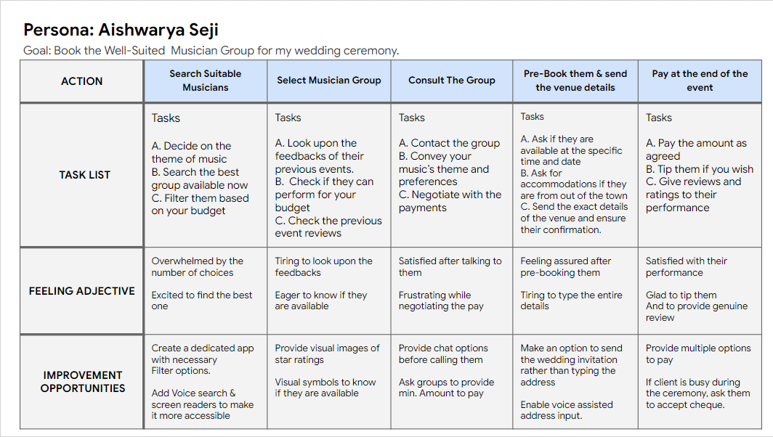
User journey map
Goal : To Book the well-suited Musician band for the wedding ceremony.

Slide 14
Persona: Aishwarya Seji
Goal: Book the Well-Suited Musician Group for my wedding ceremony.
ACTION | Search Suitable Musicians | Select Musician Group | Consult The Group | Pre-Book them & send the venue details | Pay at the end of the event
TASK LIST | Tasks A. Decide on the theme of music B. Search the best group available now C. Filter them based on your budget | Tasks A. Look upon the feedbacks of their previous events. B. Check if they can perform for your budget C. Check the previous event reviews | Tasks A. Contact the group B. Convey your music’s theme and preferences C. Negotiate with the payments | Tasks A. Ask if they are available at the specific time and date B. Ask for accommodations if they are from out of the town C. Send the exact details of the venue and ensure their confirmation. | Tasks A. Pay the amount as agreed B. Tip them if you wish C. Give reviews and ratings to their performance
FEELING ADJECTIVE | Overwhelmed by the number of choices Excited to find the best one | Tiring to look upon the feedbacks Eager to know if they are available | Satisfied after talking to them Frustrating while negotiating the pay | Feeling assured after pre-booking them Tiring to type the entire details | Satisfied with their performance Glad to tip them And to provide genuine review
IMPROVEMENT OPPORTUNITIES | Create a dedicated app with necessary Filter options. Add Voice search & screen readers to make it more accessible | Provide visual images of star ratings Visual symbols to know if they are available | Provide chat options before calling them Ask groups to provide min. Amount to pay | Make an option to send the wedding invitation rather than typing the address Enable voice assisted address input. | Provide multiple options to pay If client is busy during the ceremony, ask them to accept cheque.

Slide 15
Aishwarya Seji
Marketing Agent and she is about to marry
A Musician Booking App for her Wedding Ceremony
She don’t want to spend much money on agents and to book within her budget

Slide 16
Musician Booking App
To consult and pre-book musician groups
The customers who are looking for musicians for their wedding ceremony
Providing a way to book musicians of their best-suit based on their preferences and budget.
Analyzing the seasonal appointments and booking rates.

Slide 17
User Flow : Musician Booking App
Open App
Home Page
Search with filters
List of Bands
Select Band
Profile Page
My Profile
Consult
Wallet
N
Y
Pre Book With Venue Details
Pay
Payment
Status
N
Y
Receipt With Confirmation

Slide 18
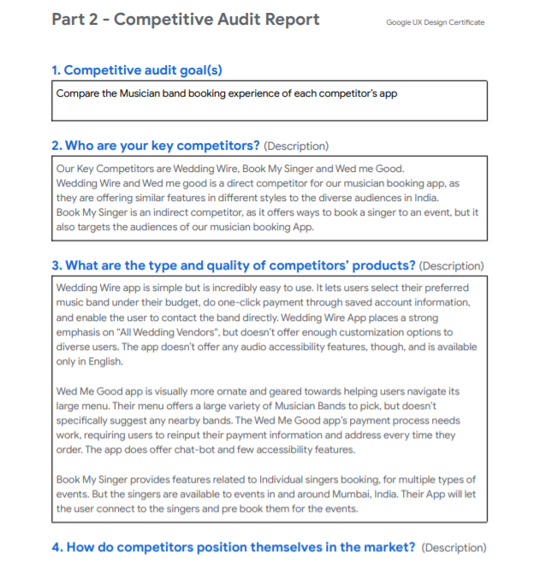
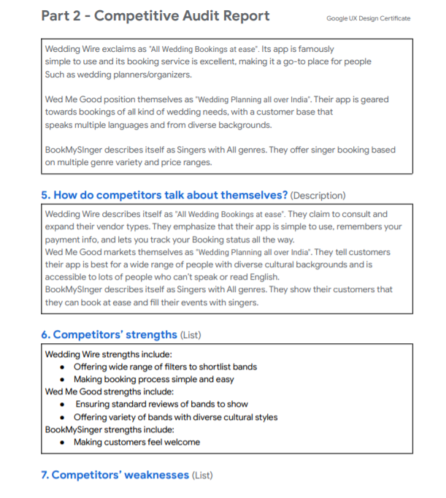
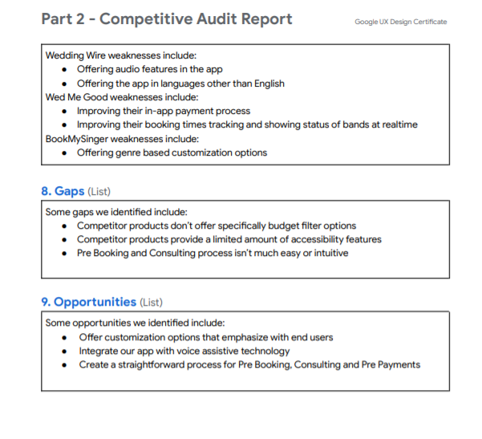
Competitive Audit & Audit Report

Slide 19
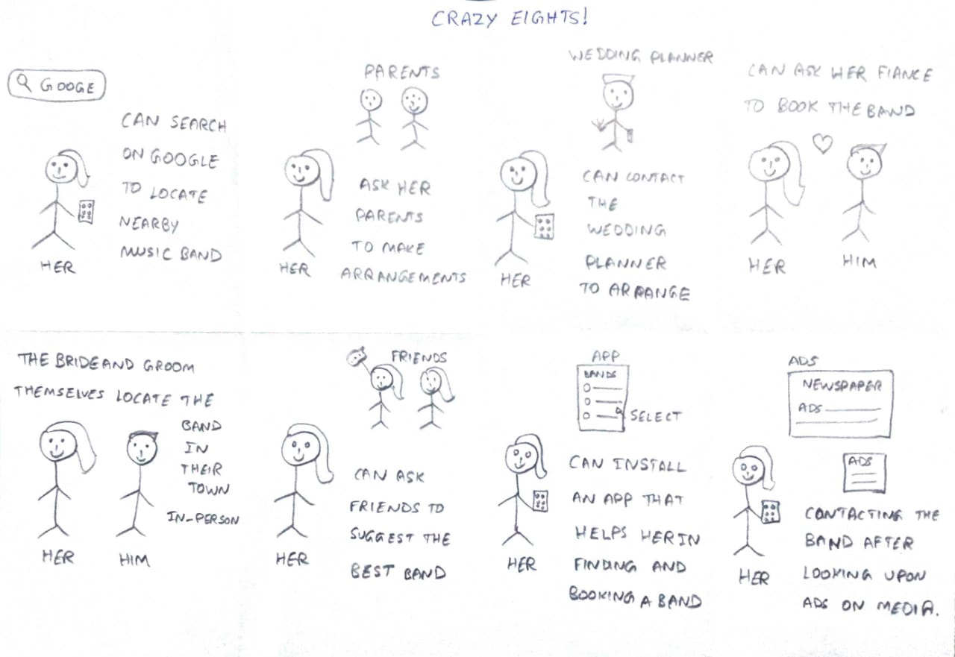
Crazy Eights : Ideas

Slide 20
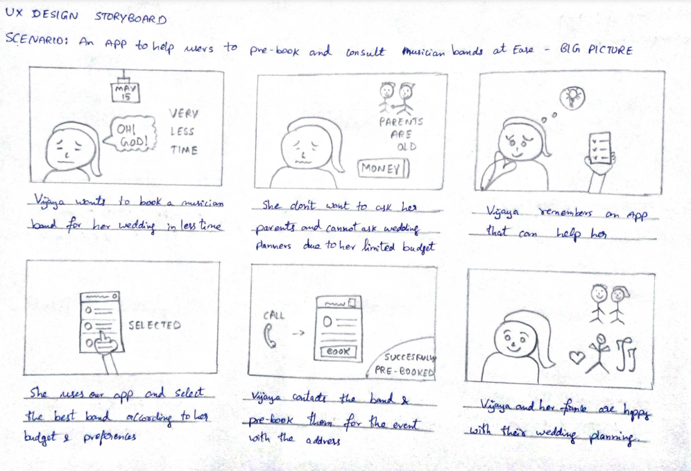
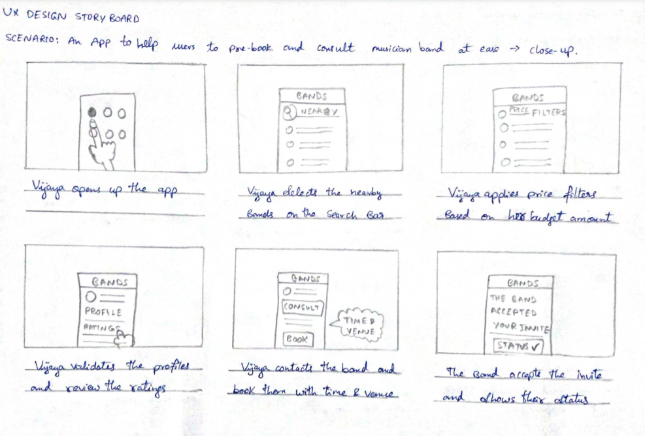
StoryBoards - Big Picture & Close Up

Slide 21

Paper wireframes
Digital wireframes
Low-fidelity prototype
Usability studies
Starting
the design

Slide 22
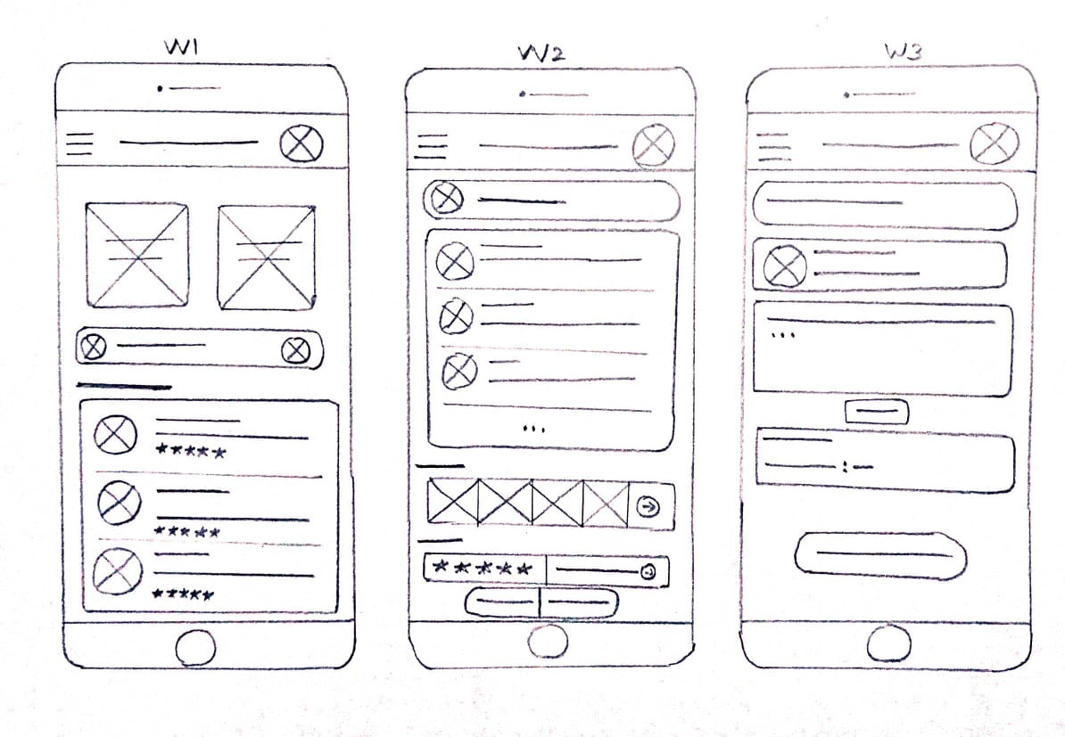
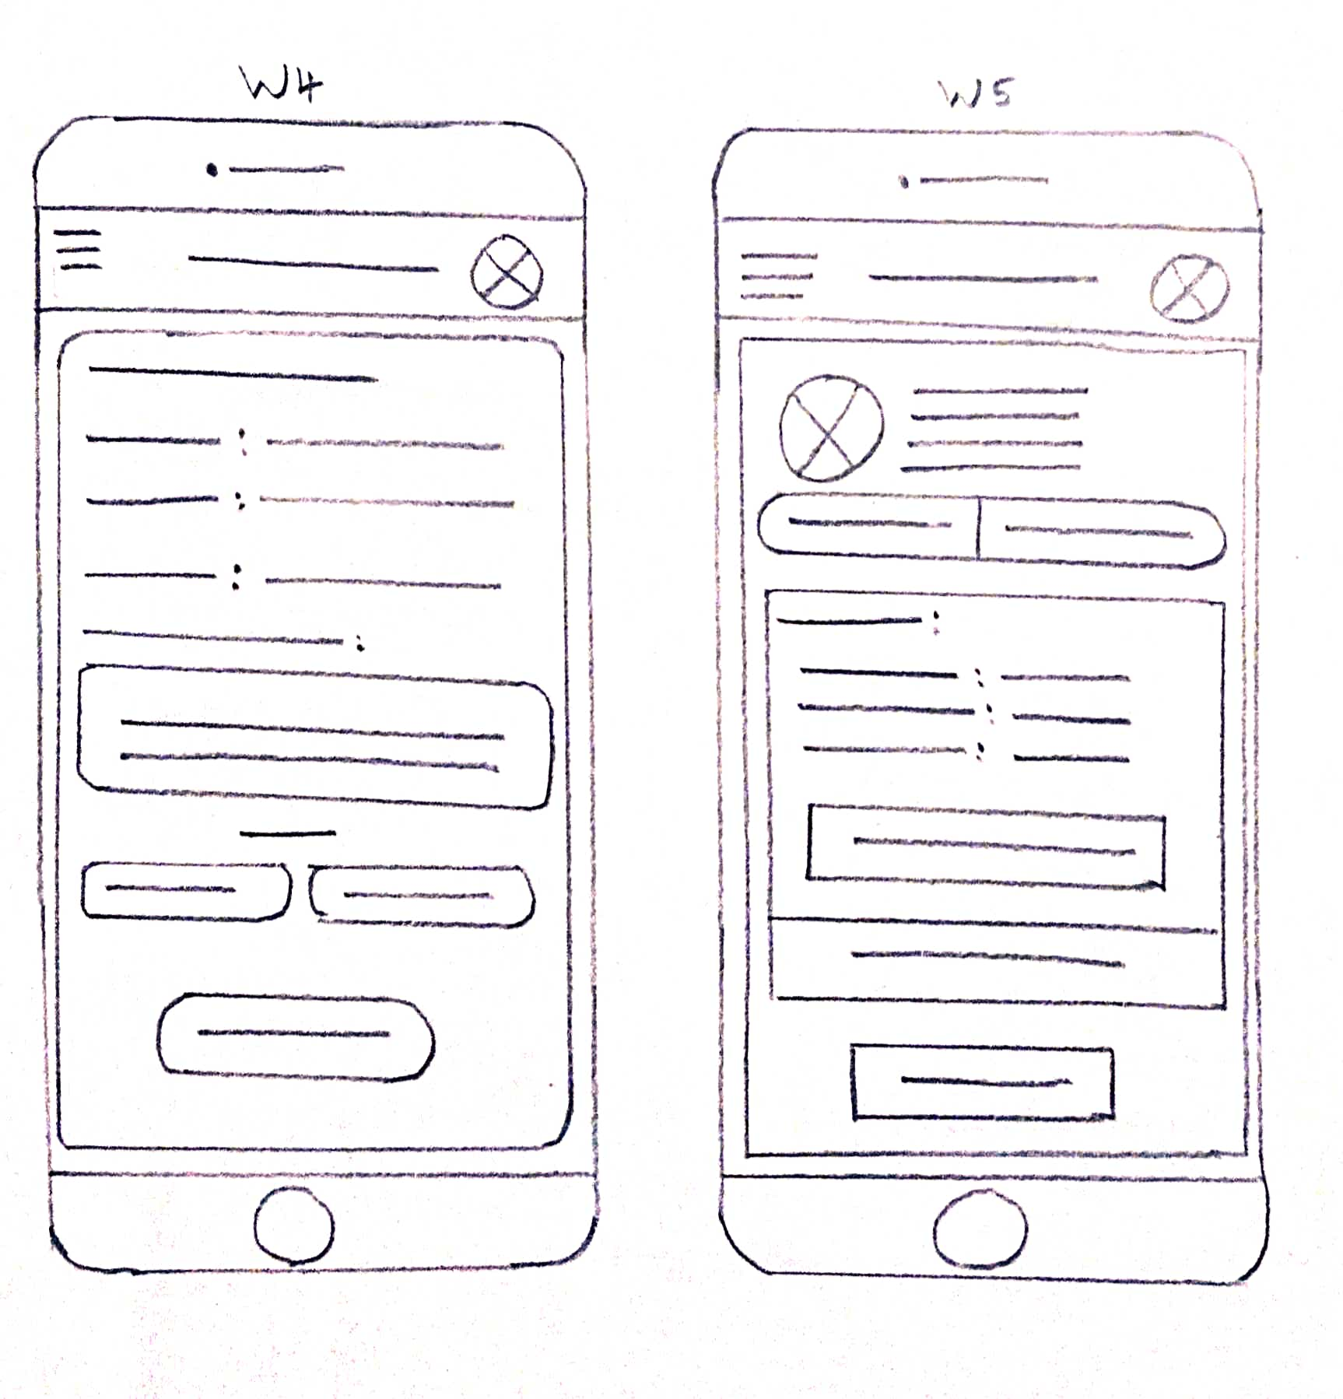
Paper wireframes
Image of paper wireframes including five different versions of the same screen and one image of the new, refined version

Slide 23
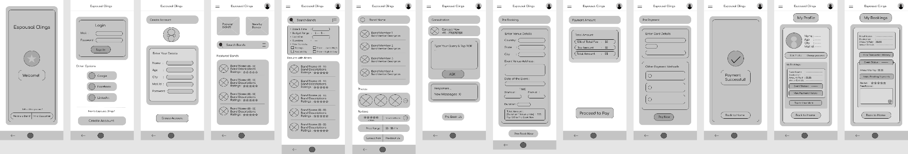
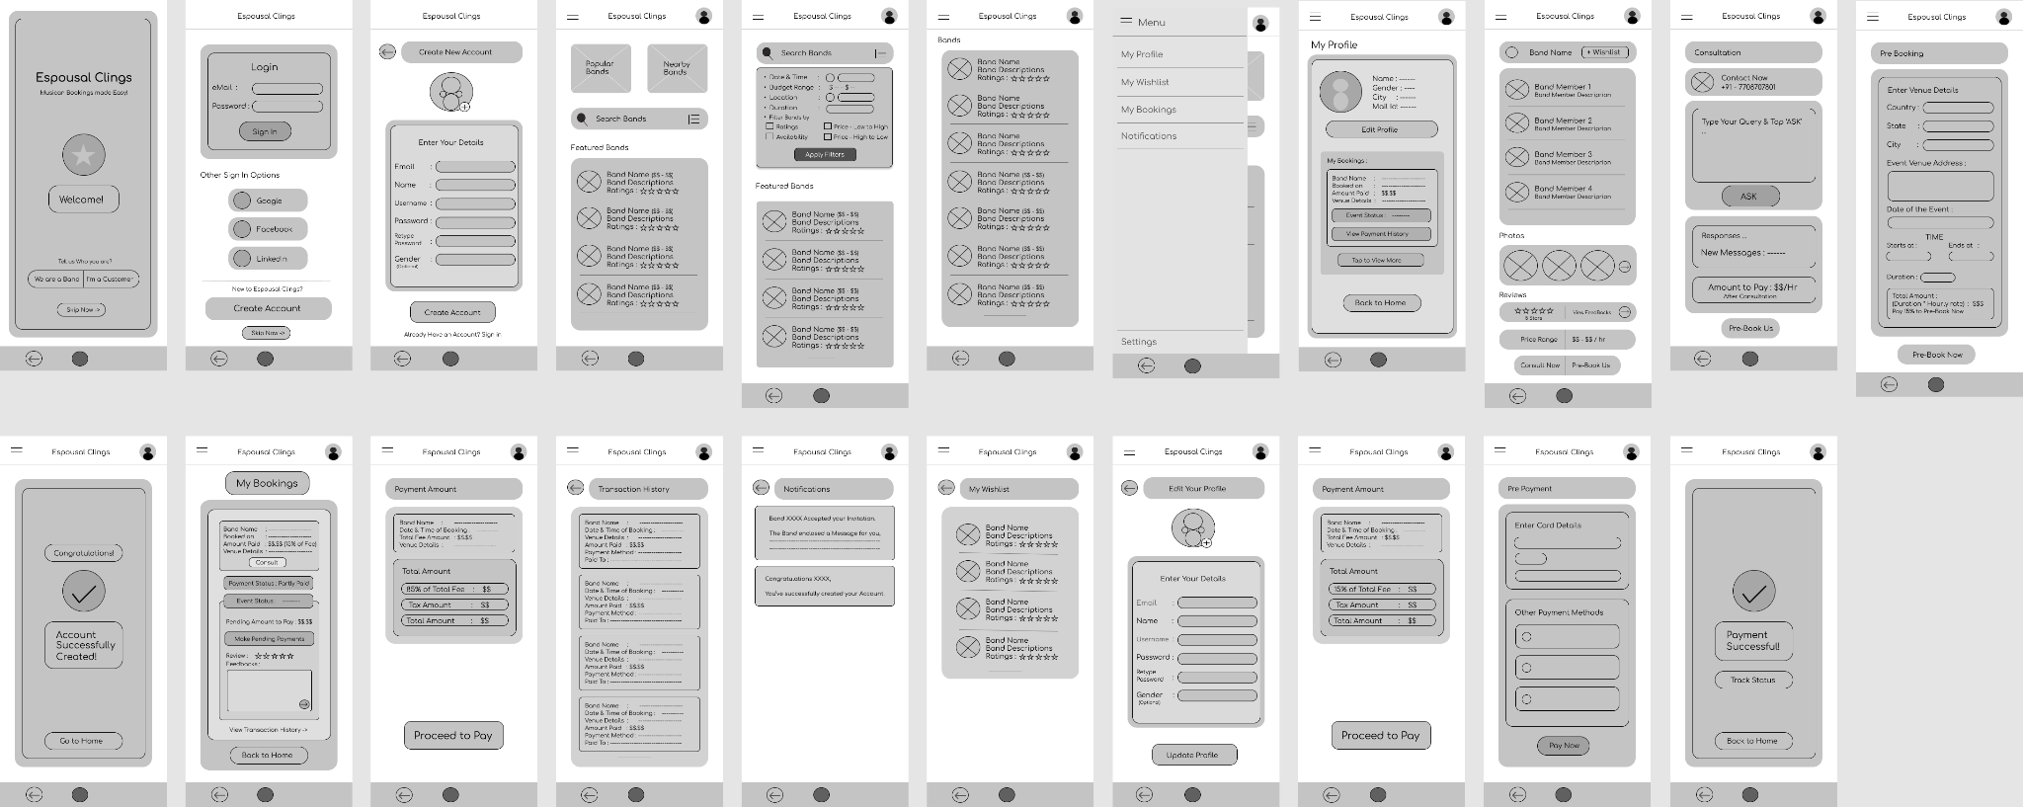
Digital wireframes

Slide 24
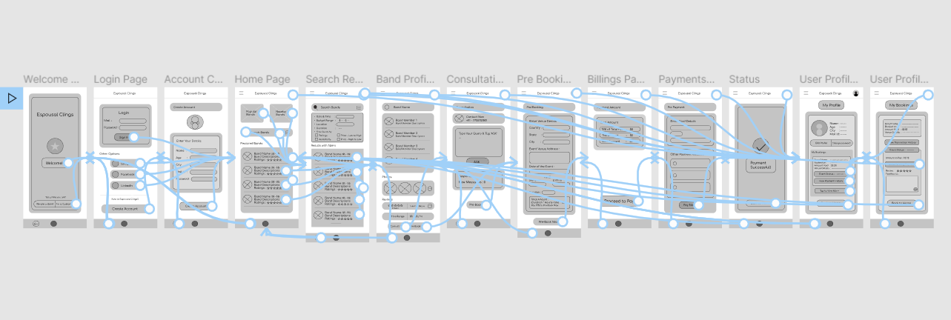
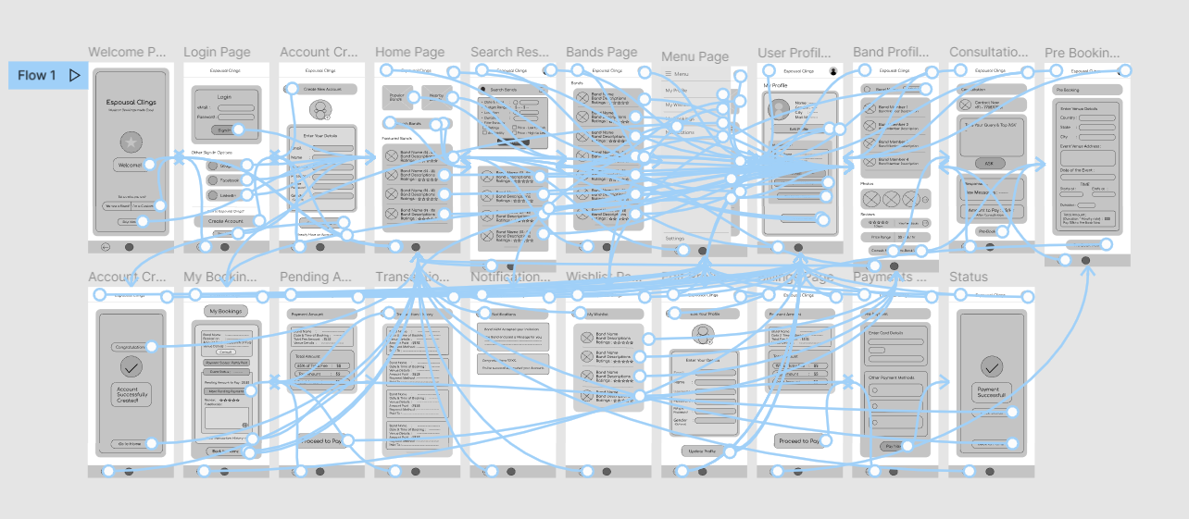
Low-fidelity prototype
Prototype Link

Slide 25

Usability Research

Slide 26
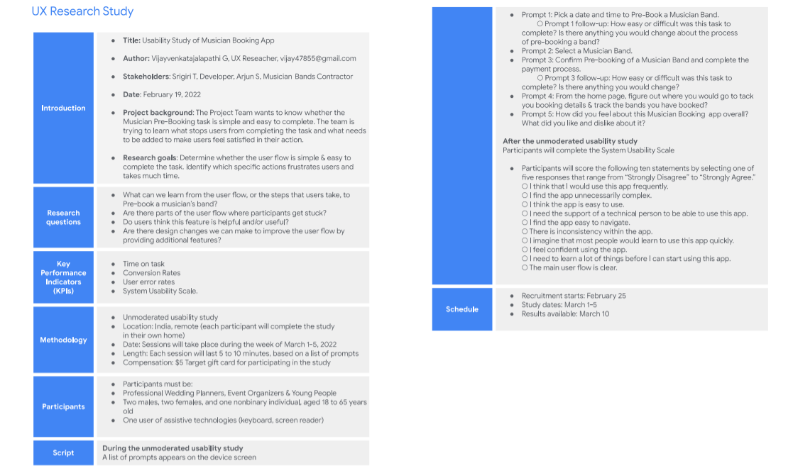
Step 1 : Planning the Study

Slide 27
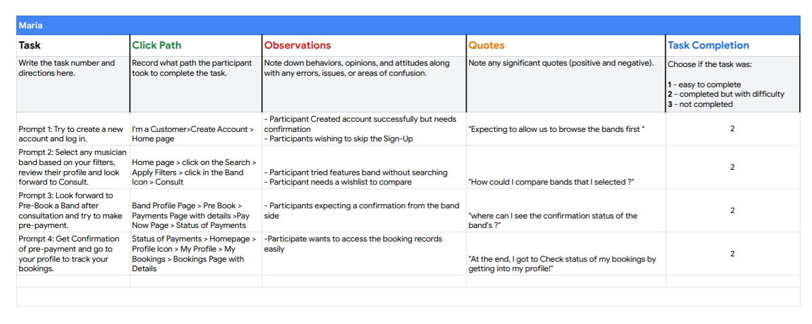
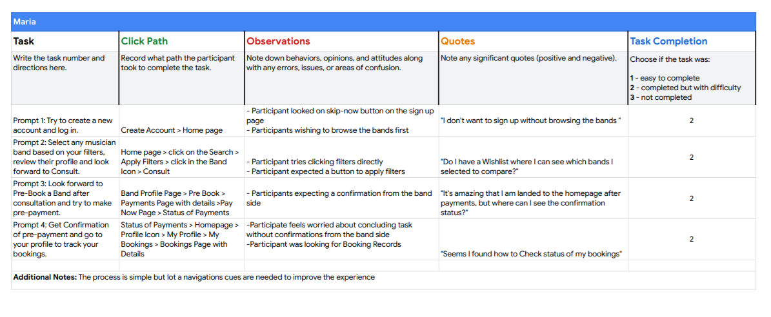
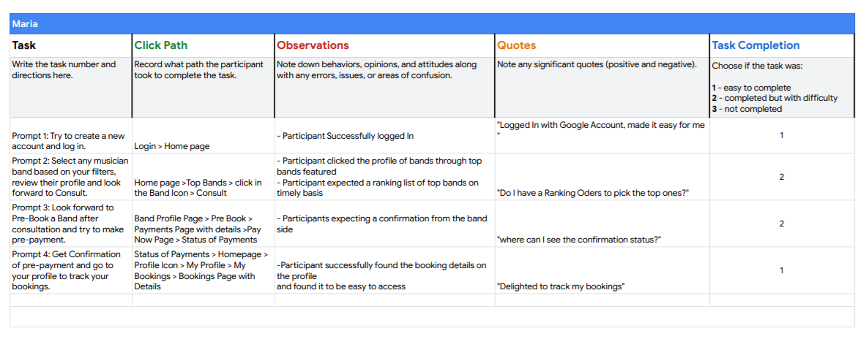
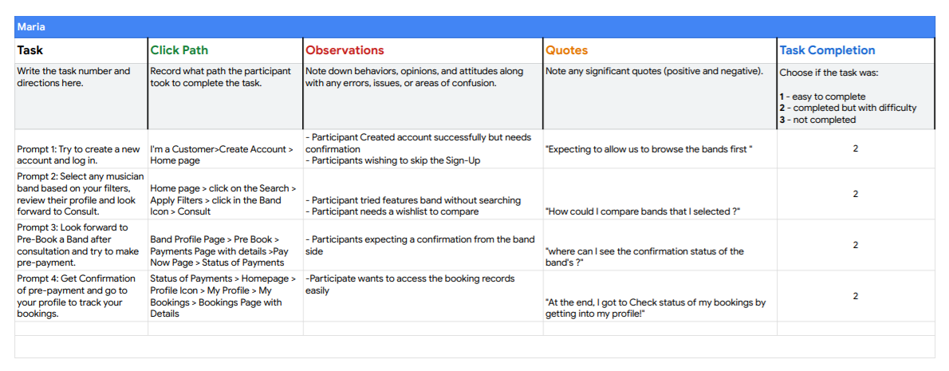
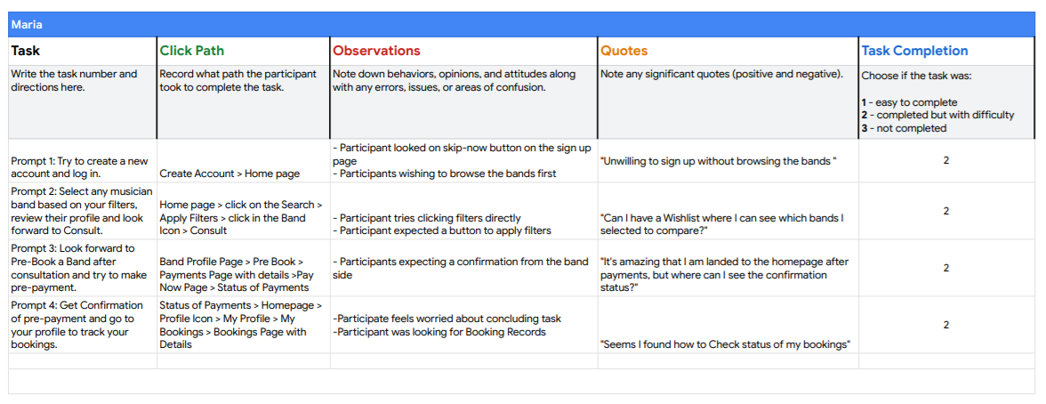
Step 2 : Conducting the Study & Spreadsheet Note Taking

Slide 28
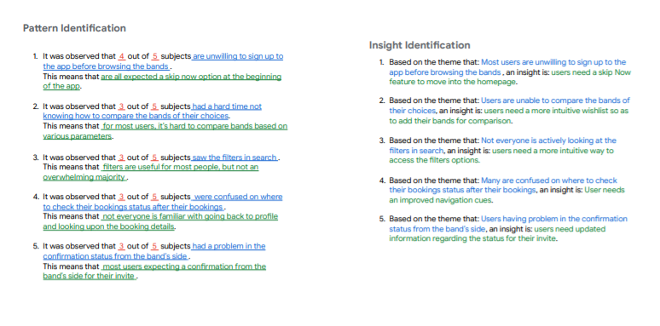
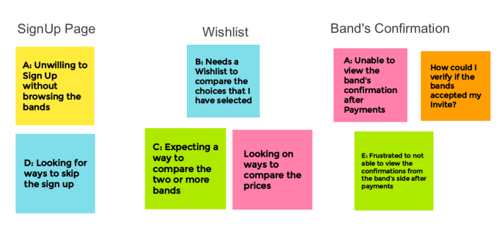
Step 3 : Analyzing & Synthesizing Data
Affinity Diagrams

Slide 29
Link to Presentation to the Stakeholders

Slide 30
Usability Study Details
Conducted by Vijay V.

Slide 31
Study Details
Research Questions
Participants
Methodology
What can we learn from the user flow, or the steps that users take, to Pre-book a musician’s band?
Are there parts of the user flow where participants get stuck?
Do users think this feature is helpful and/or useful?
Are there design changes we can make to improve the user flow by providing additional features?
5 participants
Professional Wedding Planners, Event Organizers & Young People
Two males, two females, and one nonbinary individual, aged 18 to 65 years old
One user of assistive technologies (keyboard, screen reader)
Location: India, remote (each participant will complete the study in their own home)
Date: Sessions will take place during the week of March 1-5, 2022
Length: Each session will last 5 to 10 minutes, based on a list of prompts
$15 Compensation

Slide 32
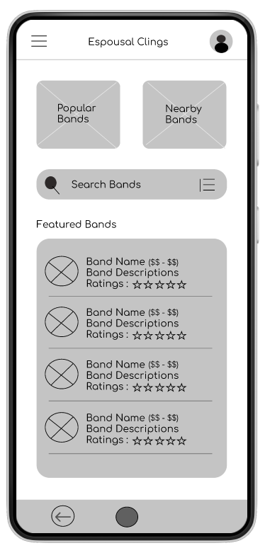
Prototype Tested
The low-fidelity app prototype for Espoual Clings App was tested and can be viewed here.

Slide 33
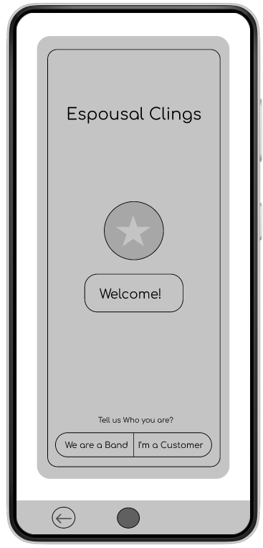
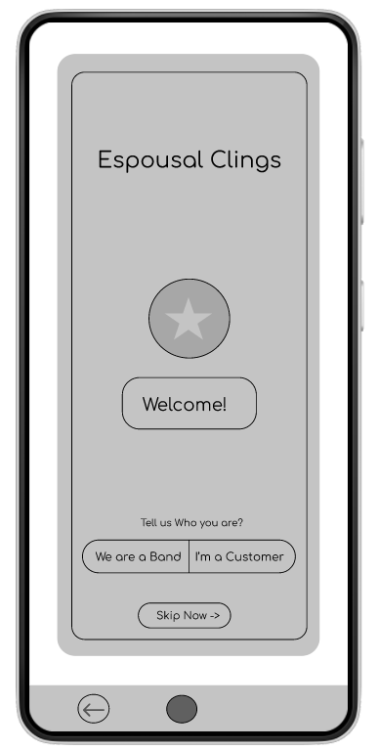
People want Skip Now feature at the Beginning
Supporting evidence from the usability study.
4 out of 5 total participants said they wanted to skip the sign up process before accessing the bands list
3 out of 5 total participants expressed a desire to sign up, if they found their preferred band
“I am expecting to skip the sign up option, am willing to browse the bands at first”
— Aishwarya Seji, Intern who is looking for bands for their wedding, India
a
Before After

Slide 34
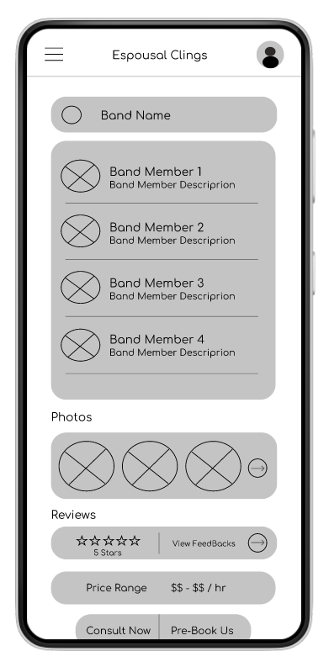
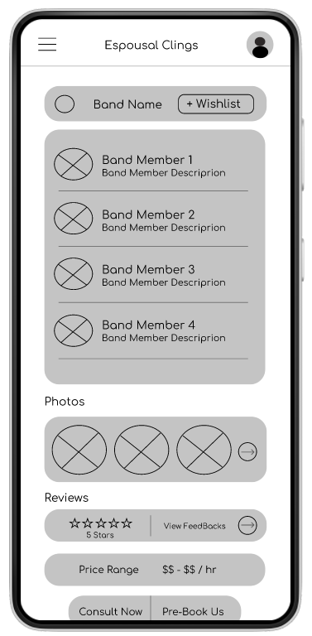
People want Wishlist Option
Supporting evidence from the usability study.
5 out of 5 total participants said they wanted the wishlist to add their preferred musician bands to look upon later.
4 of those participants said that wishlist will help them to compare the bands that they have chosen.
“I’m frustrated to compare the bands, so I would really like the option to save my preferred band to choose later.”
— Arvind Gupta, Wedding Planner, India
a
Before After

Slide 35
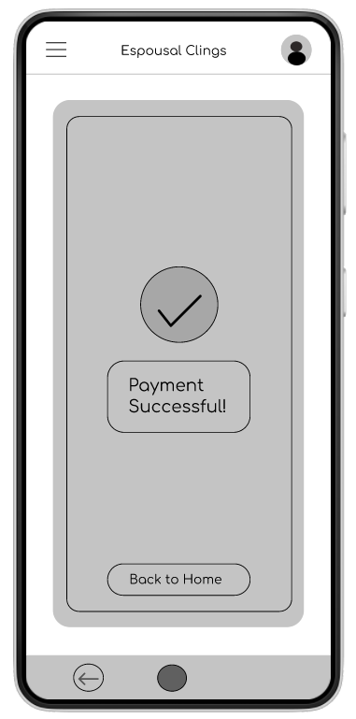
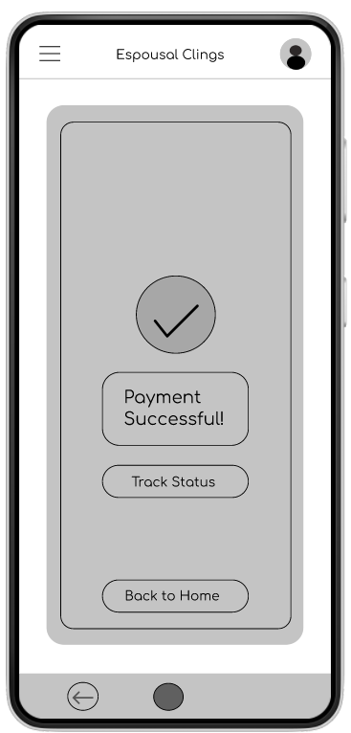
People want to know Band’s Confirmation Status
Supporting evidence from the usability study.
4 out of 5 total participants said they wanted to know the status of their bands after payments
“Just want to know if they are coming for sure, after a pre-booking.”
— Arvind Gupta, Wedding Planner, India
a
Before After

Slide 36
Insights & Recommendations

Slide 37
Research insights & Brief Review
Band’s Confirmation status
Skip Now Option
Wishlist Feature
Users need a way to skip the sign-up process before getting to the homepage.
Users need wishlist option to save and compare their preferred bands later..
Users need a way to know if the band accepted their invite.

Slide 38
Refining
the design
Mockups
High-fidelity prototype
Accessibility

Slide 39
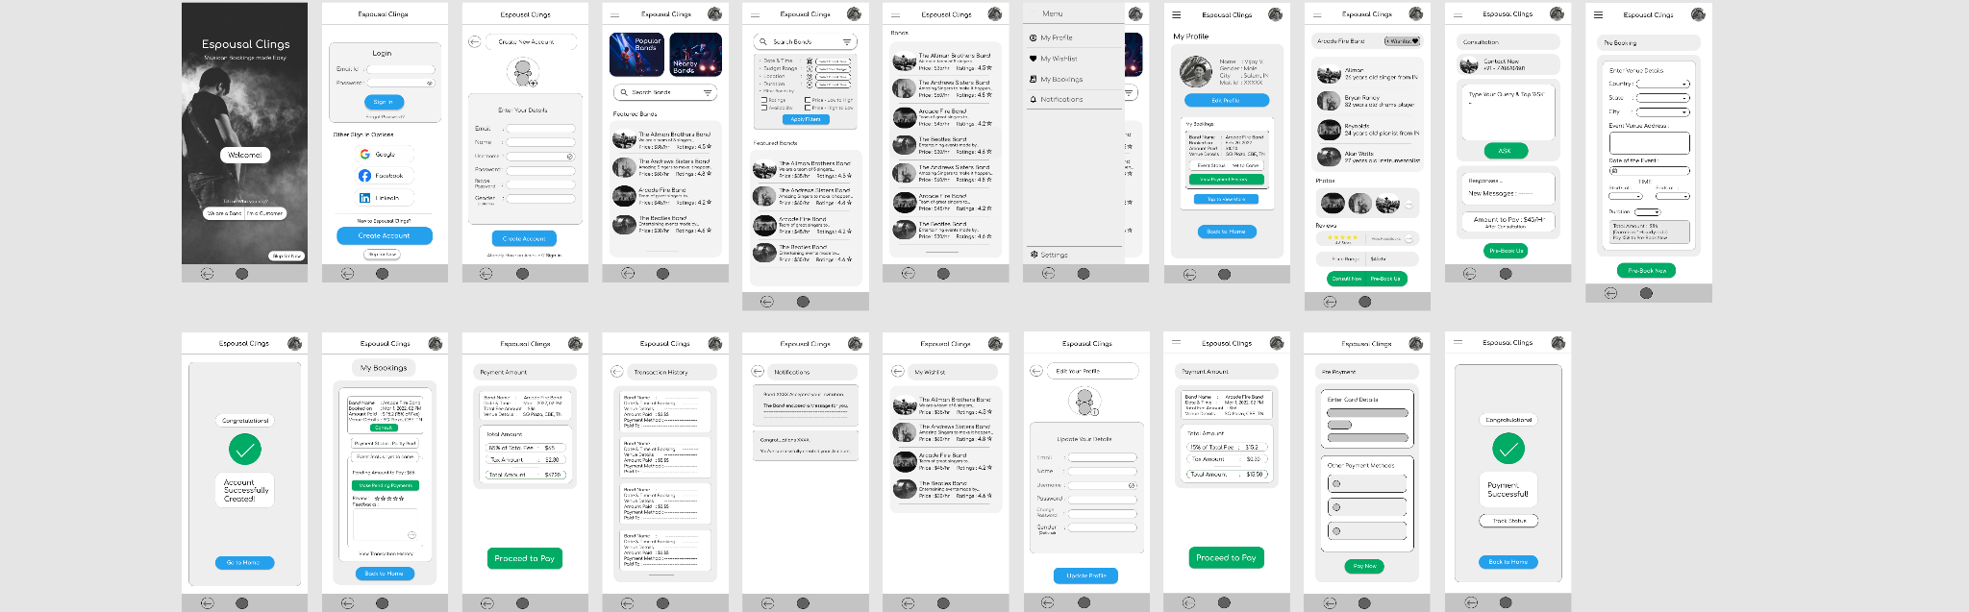
Mockups
Main mockup screen for display
Main mockup screen for display
Main mockup screen for display
Main mockup screen for display

Slide 40
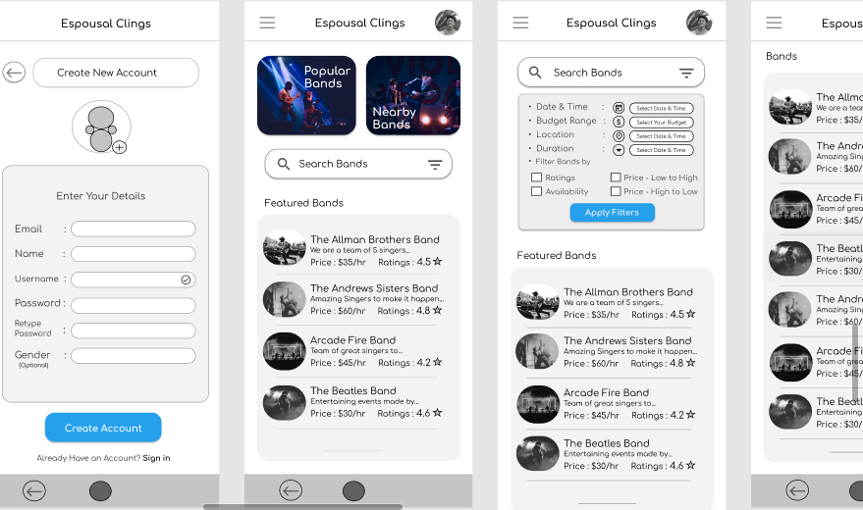
High-fidelity prototype
Link
Screenshot of prototype with connections or prototype GIF

Slide 41
Accessibility considerations
1
2
3
Screen Reader Compatibility:
Many users with visual impairments rely on screen readers to access content on their devices. Therefore, it is important to ensure that the app is compatible with screen readers, and that all content and controls are labeled properly to allow for easy navigation and use.
Color Contrast:
The app should have high color contrast to ensure that users with visual impairments can read and navigate the app with ease. This means that the color scheme should avoid low-contrast color combinations and instead use high-contrast color combinations that make it easy.
Keyboard Accessibility:
It is important to ensure that all functions of the app can be accessed using only a keyboard. This means that users should be able to navigate the app, select options and submit forms using the tab, arrow, and enter keys

